Slide 1
Mobile Phone Repairing Center
Login
User
Add a Ticket
View and Edit Ticket
Profile Update
Technician
View a Ticket
Reply to Ticket
Delete Ticket
Admin
Add Technician
Edit and Delete Technician
View a Ticket
Reply to Ticket
Delete Ticket
- Ankush Darade
- Pankaj Darade

Slide 2
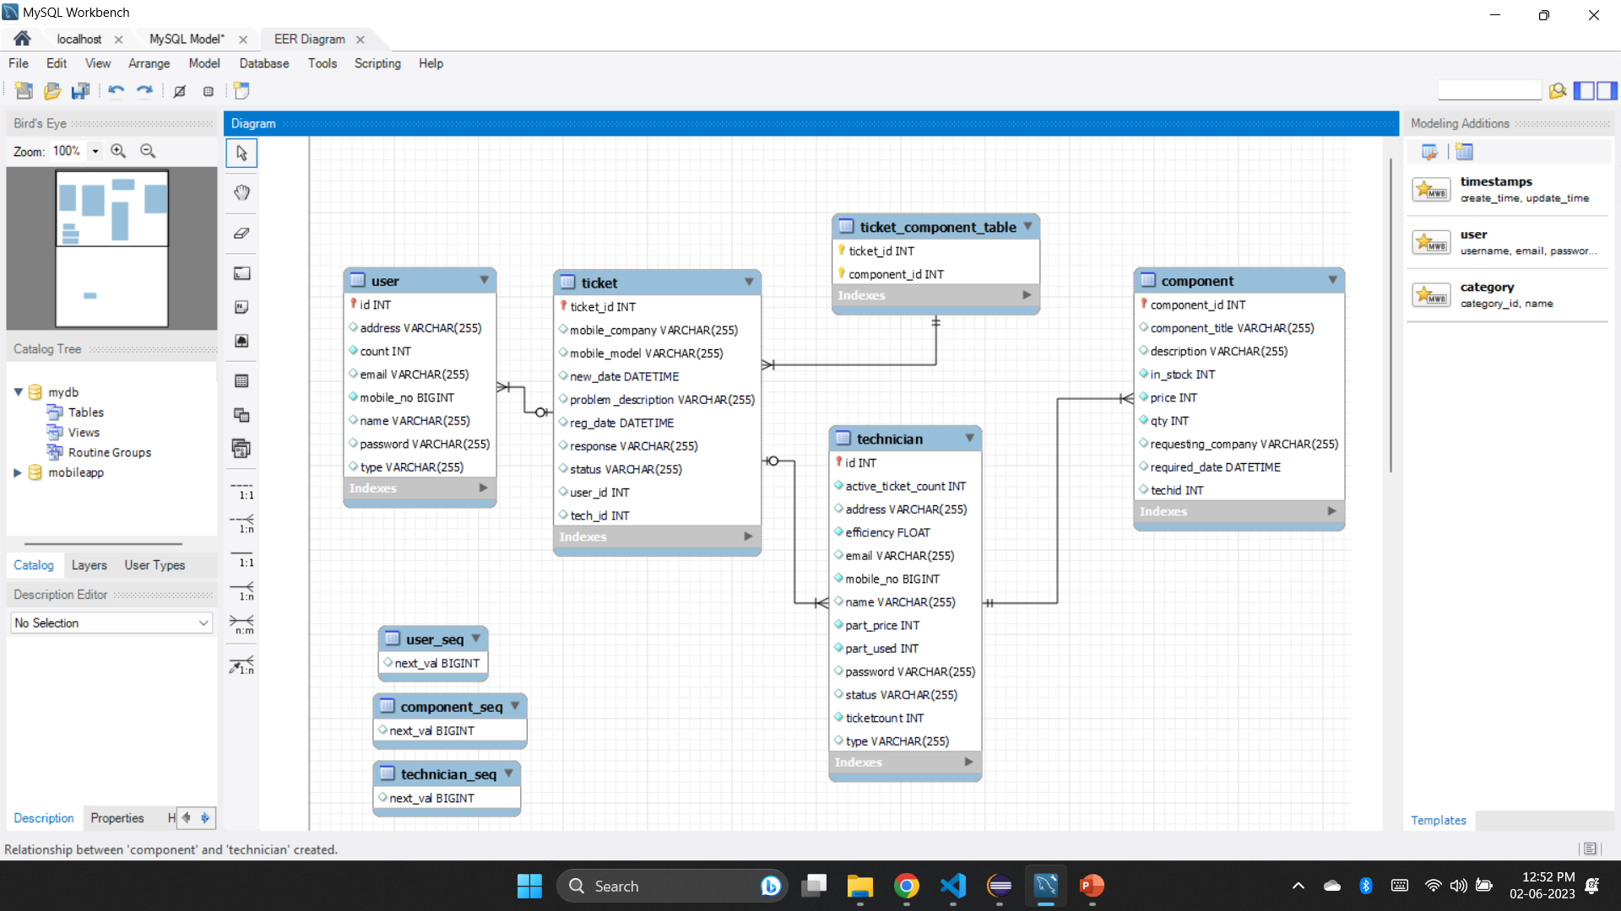
Mobile Phone Repairing Center
Login
User
Add a Ticket
View and Edit Ticket
Technician
View a Ticket
Reply to Ticket
Add Component
Admin
Add Technician
List Tech/ User
View a Ticket
Reply to Ticket
Add Components
Ankush Darade- 2260387

Slide 3
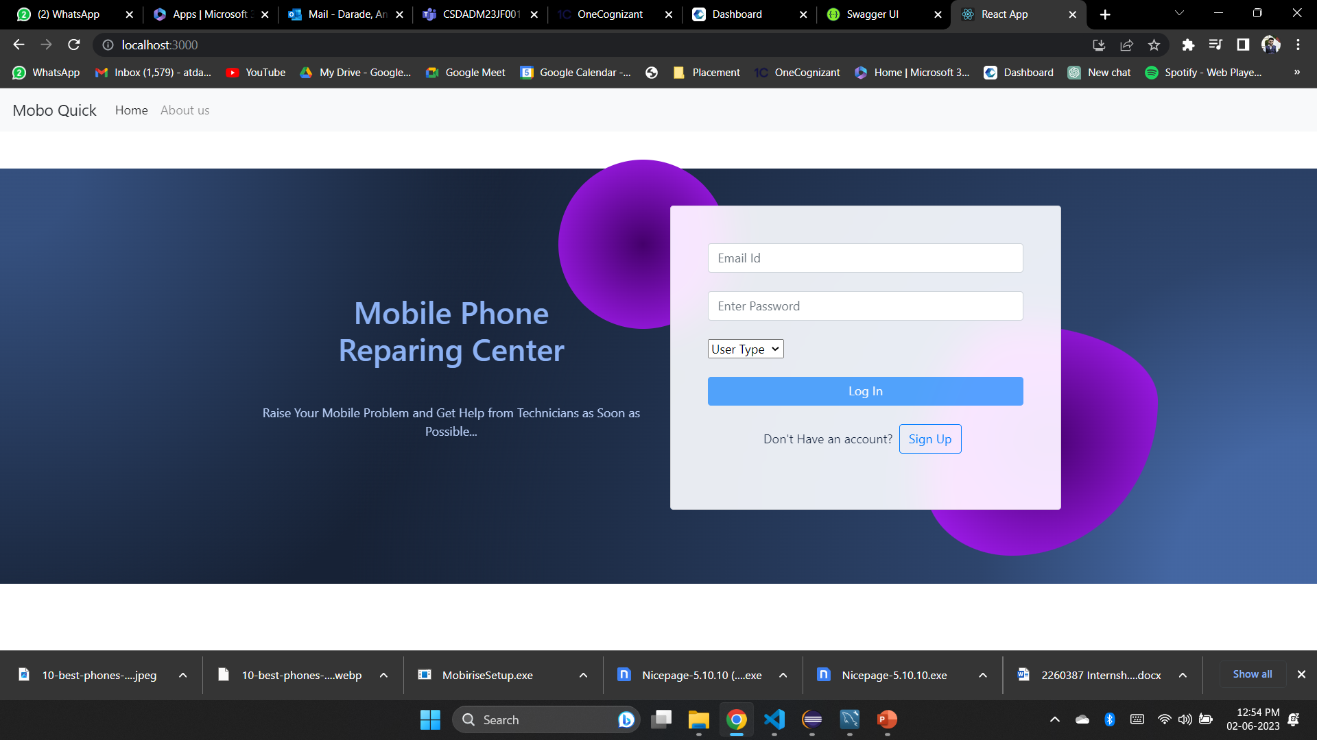
Login
User
Add a Ticket
View and Edit Ticket
Profile Update
Technician
View a Ticket
Reply to Ticket
Delete Ticket
Admin
Add Technician
Edit and Delete Technician
View a Ticket
Reply to Ticket
Delete Ticket

Slide 4
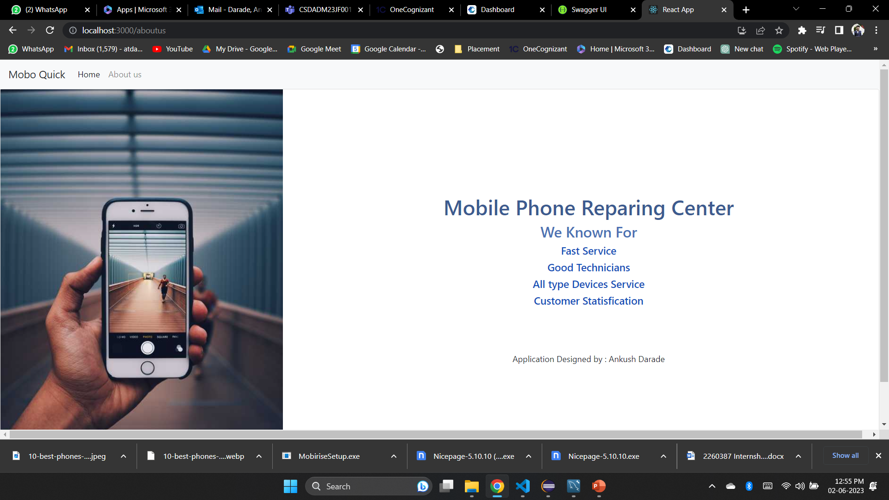

Slide 5
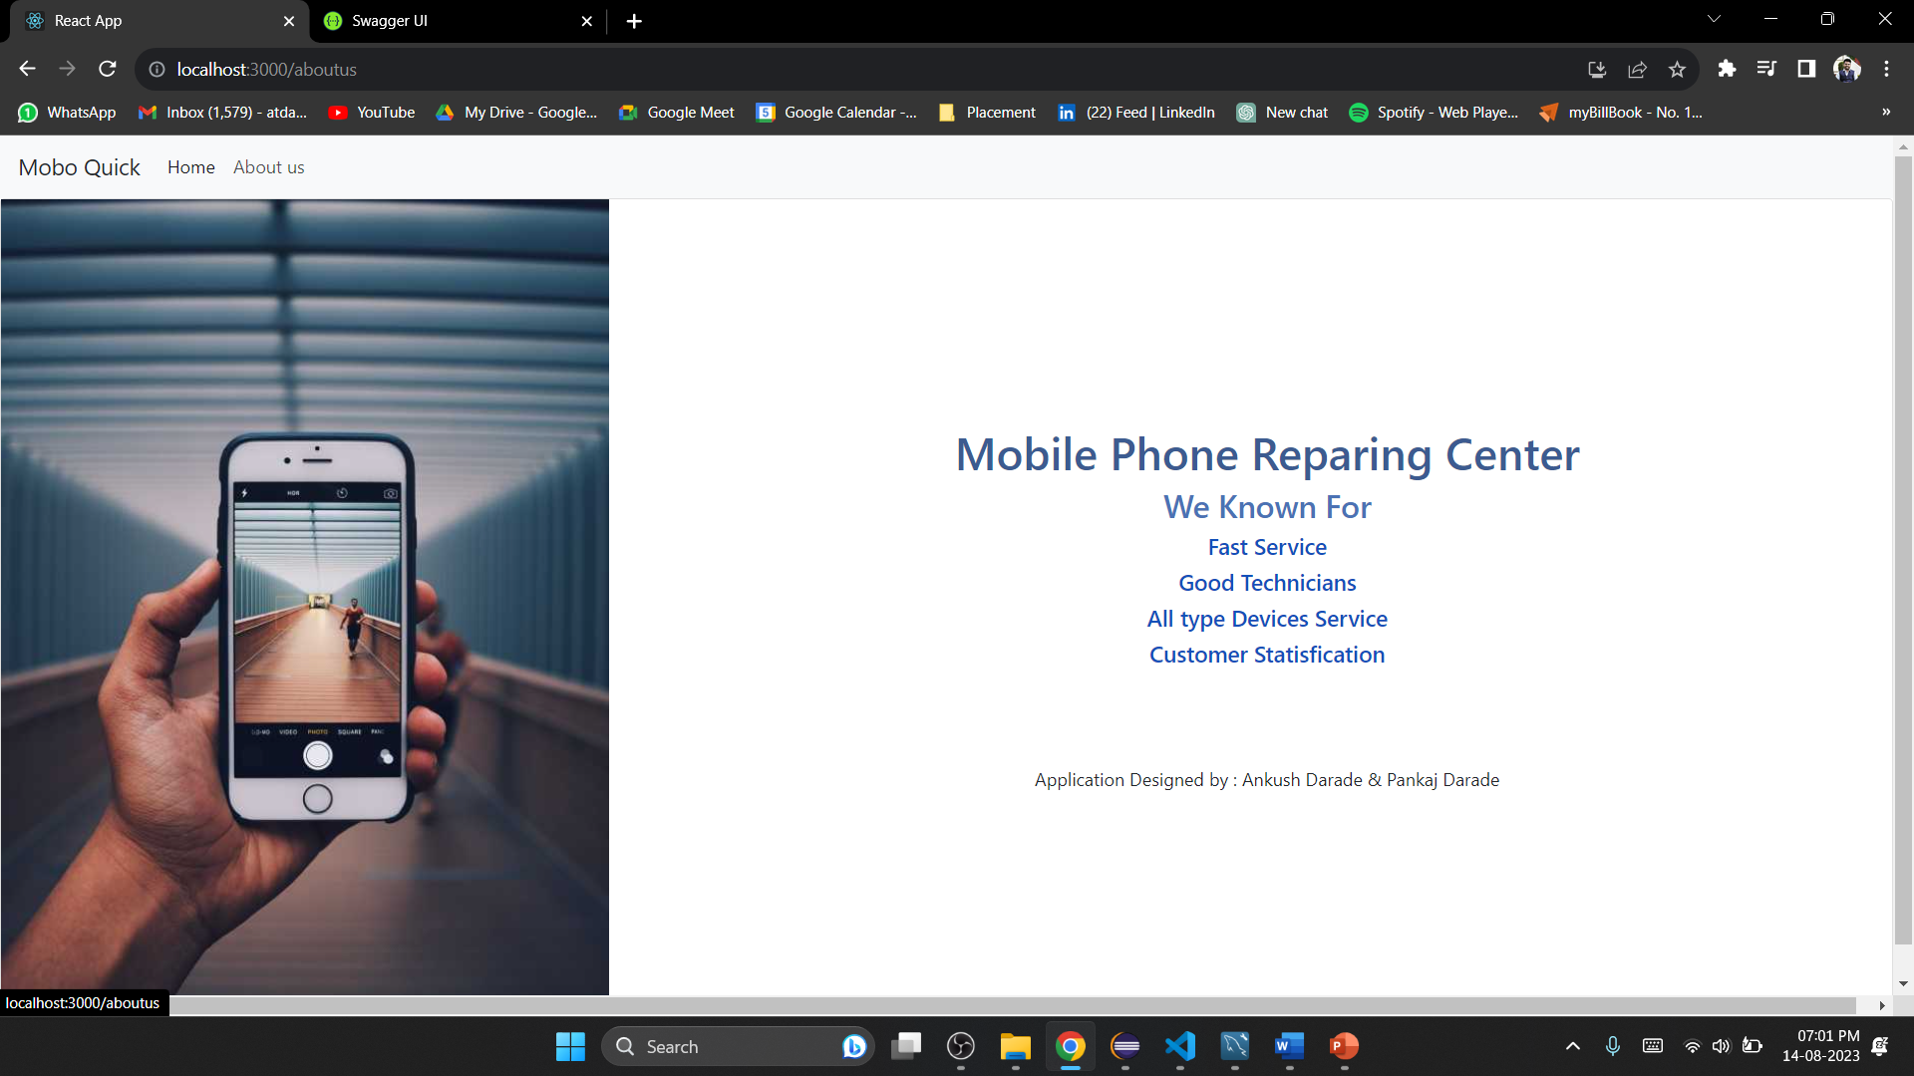
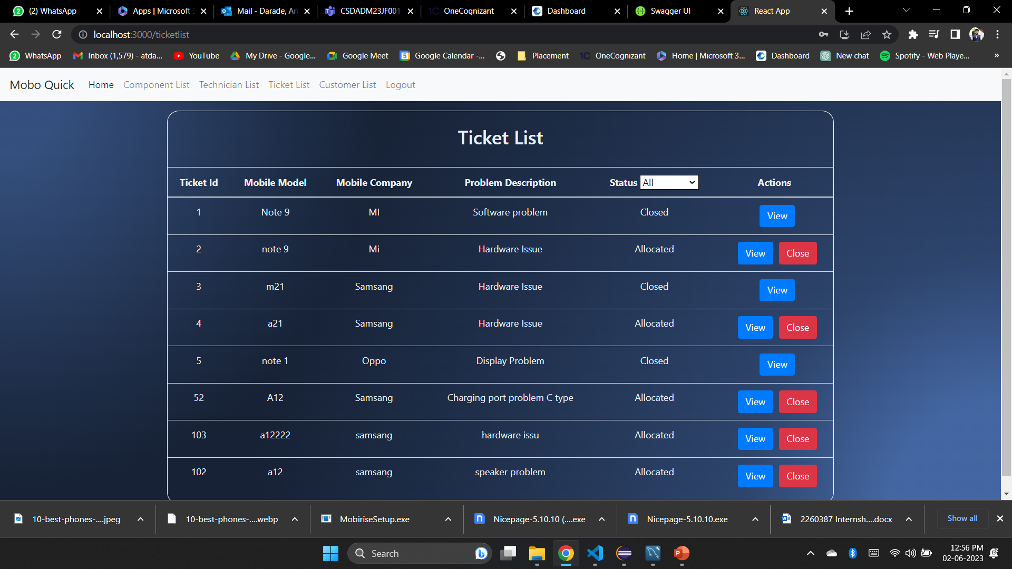

Slide 6
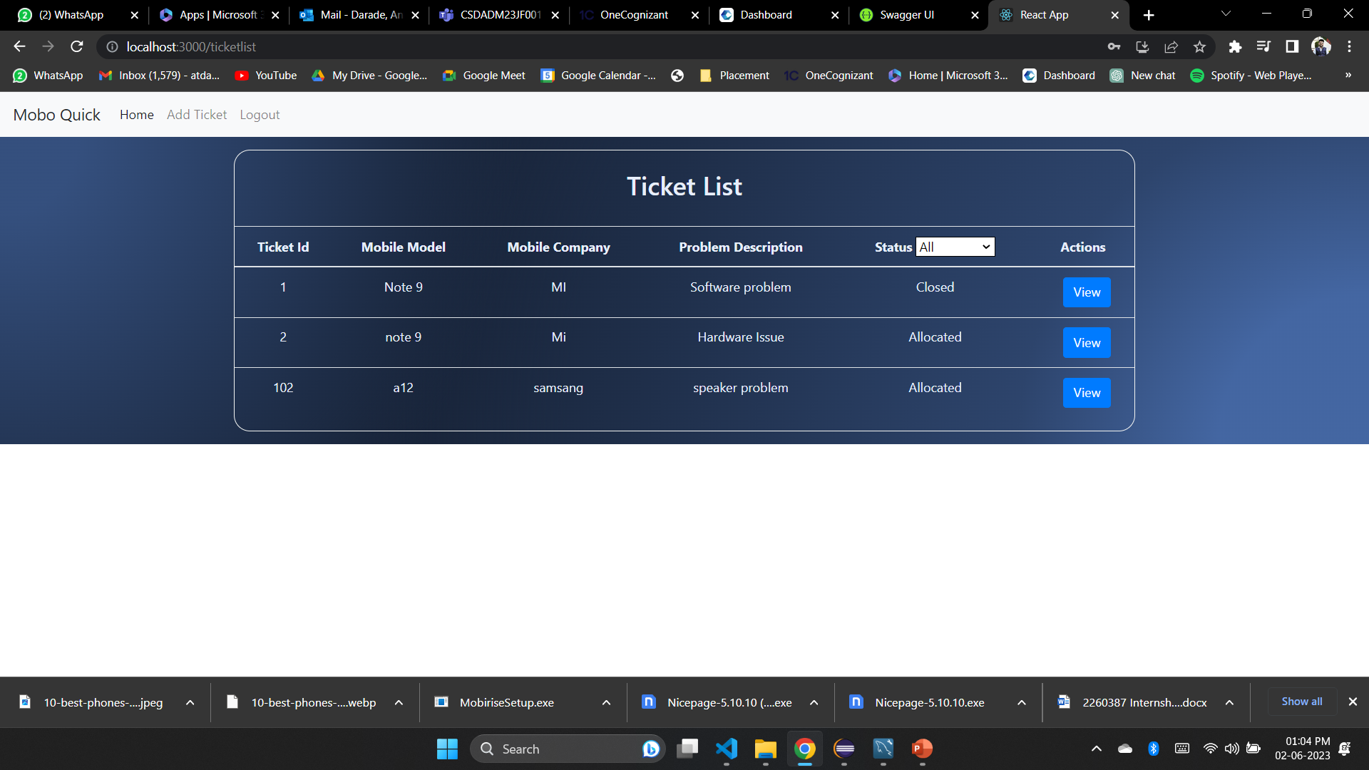
Admin Page

Slide 7
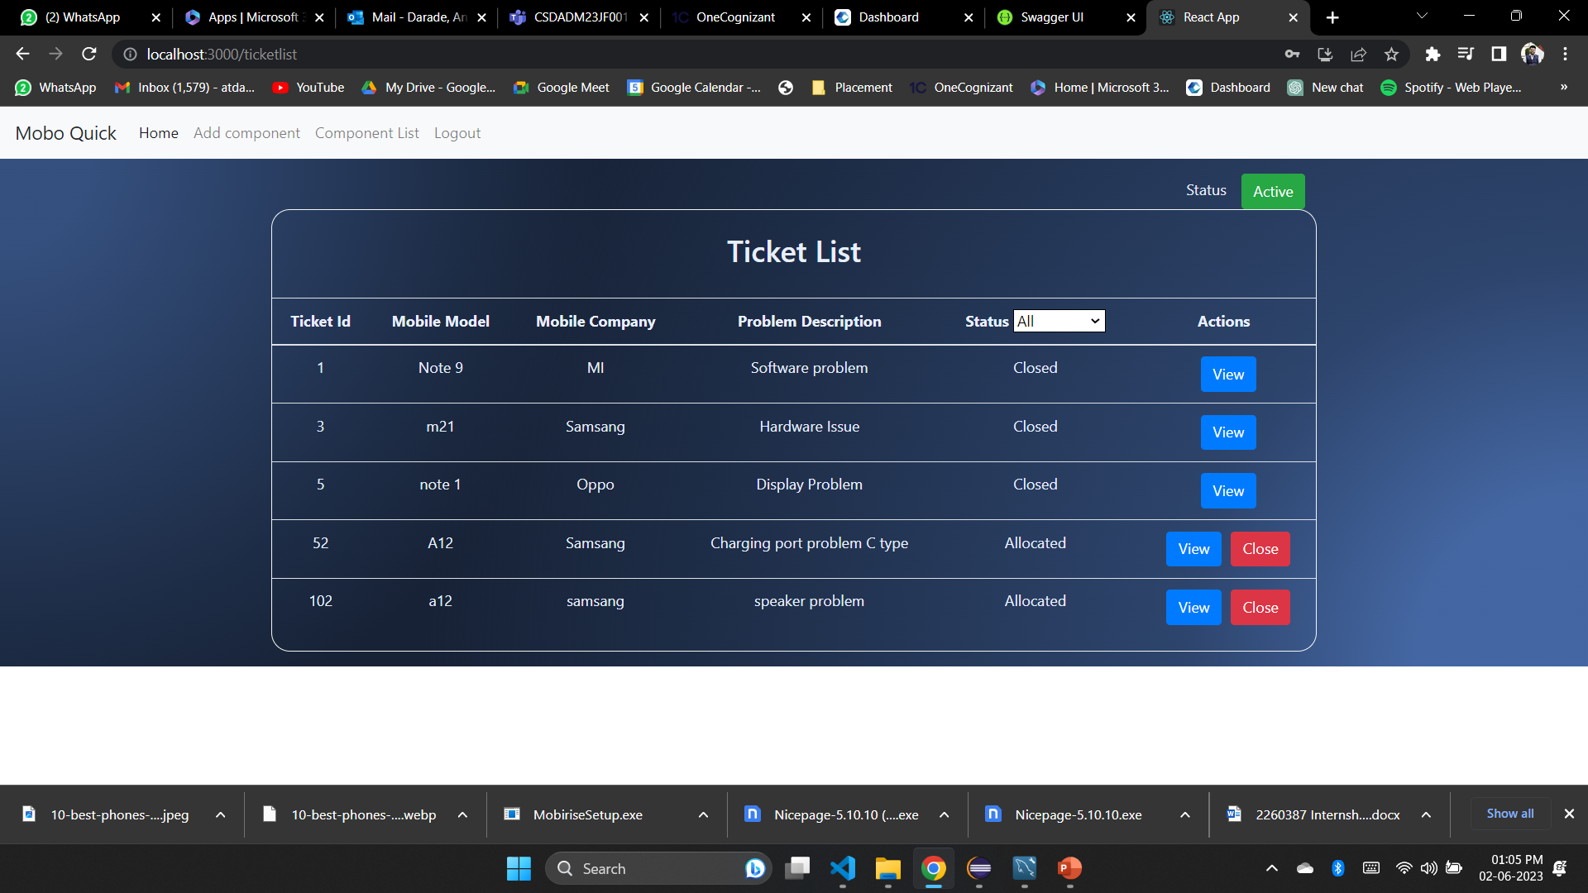
Customer Page

Slide 8
Technician Page
Thank You

Slide 9
Thank You

